Slide 1
Another Factorial Experiment
Eric Scott

Slide 2
Review of means paramaterization vs. effects paramaterization
Using our coefficients and GLM equation, we figured out the expected mean mass of caterpillars in all 4 treatment x host plant combinations:
$$E[x_{i}]=β_{0}+β_{1}H_{i}+β_{2}P_{i}+β_{3}H_{i}P_{i}$$
m4 <- glm(mass ~ host + treat + host:treat, family = gaussian(link = "identity"), data = cats) coef(m4) %>% round(2)
## (Intercept) hostPlantago ## 4.34 2.41 ## treatHerbicide hostPlantago:treatHerbicide ## -0.58 0.16
Castilleja & control = 4.34 Castilleja & herbicide = 3.76 Plantago & control = 6.76 Plantago & herbicide = 6.34
Can we get these an easier way?

Slide 3
Effects paramaterization
m_effects <- glm(mass ~ treat*host, family = gaussian, data = cats) summary(m_effects)
## ## Call: ## glm(formula = mass ~ treat * host, family = gaussian, data = cats) ## ## Deviance Residuals: ## Min 1Q Median 3Q Max ## -4.3584 -1.0738 -0.1184 0.8050 10.1316 ## ## Coefficients: ## Estimate Std. Error t value Pr(>|t|) ## (Intercept) 4.3444 0.2193 19.806 < 2e-16 *** ## treatHerbicide -0.5844 0.3162 -1.848 0.0657 . ## hostPlantago 2.4144 0.2778 8.690 3.14e-16 *** ## treatHerbicide:hostPlantago 0.1639 0.3998 0.410 0.6821 ## --- ## Signif. codes: 0 '***' 0.001 '**' 0.01 '*' 0.05 '.' 0.1 ' ' 1 ## ## (Dispersion parameter for gaussian family taken to be 2.646255) ## ## Null deviance: 1166.64 on 282 degrees of freedom ## Residual deviance: 738.31 on 279 degrees of freedom ## AIC: 1084.5 ## ## Number of Fisher Scoring iterations: 2
Anova(m_effects)
## Analysis of Deviance Table (Type II tests) ## ## Response: mass ## LR Chisq Df Pr(>Chisq) ## treat 6.200 1 0.01278 * ## host 155.777 1 < 2e-16 *** ## treat:host 0.168 1 0.68177 ## --- ## Signif. codes: 0 '***' 0.001 '**' 0.01 '*' 0.05 '.' 0.1 ' ' 1

Slide 4
Means paramaterization
Not quite what we want in this case
m_means <- glm(mass ~ -1 + treat*host, family = gaussian, data = cats) summary(m_means)
## ## Call: ## glm(formula = mass ~ -1 + treat * host, family = gaussian, data = cats) ## ## Deviance Residuals: ## Min 1Q Median 3Q Max ## -4.3584 -1.0738 -0.1184 0.8050 10.1316 ## ## Coefficients: ## Estimate Std. Error t value Pr(>|t|) ## treatControl 4.3444 0.2193 19.81 < 2e-16 *** ## treatHerbicide 3.7600 0.2278 16.51 < 2e-16 *** ## hostPlantago 2.4144 0.2778 8.69 3.14e-16 *** ## treatHerbicide:hostPlantago 0.1639 0.3998 0.41 0.682 ## --- ## Signif. codes: 0 '***' 0.001 '**' 0.01 '*' 0.05 '.' 0.1 ' ' 1 ## ## (Dispersion parameter for gaussian family taken to be 2.646255) ## ## Null deviance: 10109.41 on 283 degrees of freedom ## Residual deviance: 738.31 on 279 degrees of freedom ## AIC: 1084.5 ## ## Number of Fisher Scoring iterations: 2
treatControl = expected mean of Castilleja & control
treatHerbicide = expected mean of Castilleja & herbicide
hostPlantago = difference in means between treatControl and Plantago & control
treatHerbicide:hostPlantago = difference in means between treatHerbicide and Plantago & herbicide

Slide 5
Means paramterization
Also, if you use means paramaterization (~ -1 + treat*host), then the Anova() results are not correct!
m_effects$call
## glm(formula = mass ~ treat * host, family = gaussian, data = cats)
Anova(m_effects)
## Analysis of Deviance Table (Type II tests) ## ## Response: mass ## LR Chisq Df Pr(>Chisq) ## treat 6.200 1 0.01278 * ## host 155.777 1 < 2e-16 *** ## treat:host 0.168 1 0.68177 ## --- ## Signif. codes: 0 '***' 0.001 '**' 0.01 '*' 0.05 '.' 0.1 ' ' 1
m_means$call
## glm(formula = mass ~ -1 + treat * host, family = gaussian, data = cats)
Anova(m_means)
## Analysis of Deviance Table (Type II tests) ## ## Response: mass ## LR Chisq Df Pr(>Chisq) ## treat 667.52 2 <2e-16 *** ## host 155.78 1 <2e-16 *** ## treat:host 0.17 1 0.6818 ## --- ## Signif. codes: 0 '***' 0.001 '**' 0.01 '*' 0.05 '.' 0.1 ' ' 1

Slide 6
Confidence intervals for factorial GLM
Can we use confint()?
confint(m_means)
## Waiting for profiling to be done...
## 2.5 % 97.5 % ## treatControl 3.9144487 4.7742786 ## treatHerbicide 3.3135438 4.2064562 ## hostPlantago 1.8698769 2.9589783 ## treatHerbicide:hostPlantago -0.6196764 0.9475655
confint(m_effects)
## Waiting for profiling to be done...
## 2.5 % 97.5 % ## (Intercept) 3.9144487 4.77427861 ## treatHerbicide -1.2041620 0.03543472 ## hostPlantago 1.8698769 2.95897826 ## treatHerbicide:hostPlantago -0.6196764 0.94756548
… same problem

Slide 7
A hack to get CIs for each group
Take out the intercept and main effects to only get means for the interactions.
m_effects_b <- glm(mass ~ -1 + treat:host, family = gaussian, data= cats) coef(m_effects_b)
## treatControl:hostCastilleja treatHerbicide:hostCastilleja ## 4.344364 3.760000 ## treatControl:hostPlantago treatHerbicide:hostPlantago ## 6.758791 6.338372
confint(m_effects_b)
## Waiting for profiling to be done...
## 2.5 % 97.5 % ## treatControl:hostCastilleja 3.914449 4.774279 ## treatHerbicide:hostCastilleja 3.313544 4.206456 ## treatControl:hostPlantago 6.424563 7.093020 ## treatHerbicide:hostPlantago 5.994565 6.682179
Remember, don’t use Anova() or AIC() on this model! Wrong # of parameters!

Slide 8
Plotting error bars
You can plot means ± SE, BUT these cannot be interpreted the same way ast 95% confidence intervals?
Making data for plot from MLE means and confidence intervals.
plotdata <- tibble(treat = c("Control", "Herbicide", "Control", "Herbicide"), host = c("Castilleja", "Castilleja", "Plantago", "Plantago"), mass = coef(m_effects_b), ci.lower = confint(m_effects_b)[ , 1],#first column ci.upper = confint(m_effects_b)[ , 2]) #second column
## Waiting for profiling to be done... ## Waiting for profiling to be done...
plotdata
## # A tibble: 4 x 5 ## treat host mass ci.lower ci.upper ## <chr> <chr> <dbl> <dbl> <dbl> ## 1 Control Castilleja 4.34 3.91 4.77 ## 2 Herbicide Castilleja 3.76 3.31 4.21 ## 3 Control Plantago 6.76 6.42 7.09 ## 4 Herbicide Plantago 6.34 5.99 6.68

Slide 9
Plot
ggplot(plotdata, aes(x = host, y = mass, color = treat)) + geom_point(size = 3) + geom_errorbar(aes(ymin = ci.lower, ymax = ci.upper), width = 0.2) + labs(title = "Predicted means ± 95% CI", x = "Host Plant", y = "mean mass at diapause", color = "treatment")

Slide 10
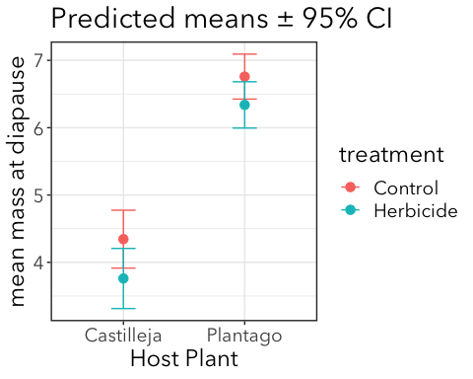

Slide 11
95% confidence intervals don’t overlap means.

Slide 12
Plotting data and means
It’s a good idea to plot raw data in addition to means ± some measure of uncertainty. BUT, it can get ugly looking fast.
Some tips:
For categorical predictors like this, “jitter” points to make them more visible
Use alpha to make raw data more transparent and fade into the background
Use different symbols for means and data points
Make symbols for means larger than data points
“dodge” means and errorbars to make overlap easier to see
Don’t include raw data if it severely compromises readability of the plot

Slide 13
ggplot code
Start with raw data
p1 <- ggplot(cats, aes(x = host, y = mass, color = treat)) + geom_jitter(alpha = 0.3, position = position_jitterdodge()) p1

Slide 14
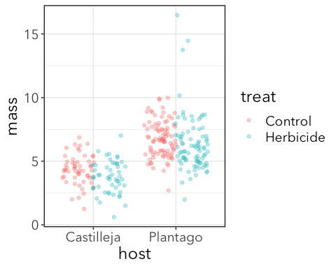

Slide 15
ggplot code
Add errorbars first because I want them to be behind the points for means
p2 <- p1 + geom_errorbar(data = plotdata, aes(ymin = ci.lower, ymax = ci.upper, group = treat), color = "black", width = 0.2, position = position_dodge(width = 0.75)) p2

Slide 16
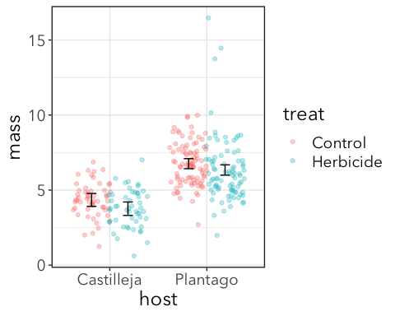

Slide 17
ggplot code
Add means with same dodge
p3 <- p2 + geom_point(data = plotdata, aes(fill = treat), size = 3, shape = "square filled", color = "black", position = position_dodge(width = 0.75)) p3

Slide 18
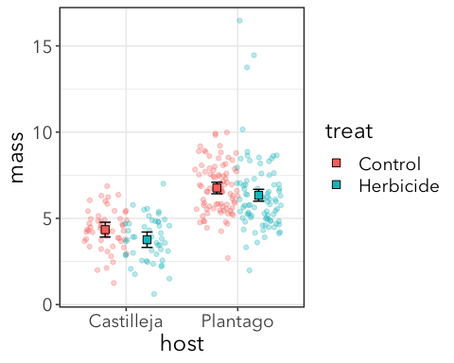

Slide 19
Another factorial experiment

Slide 20
1. Choose a probability distribution
Continuous
Approximately(?) bell shaped & symmetric
Probably close enough to Normal (AKA Gaussian)

Slide 21
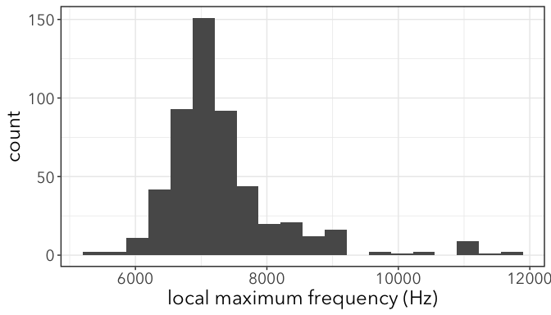

Slide 22
2. Fit “full” model & marginal hypothesis test
2 dummy variables:
O (origin) = 1 if roadside, 0 if non-roadside
T (treatment) = 1 if noisy, 0 if quiet
$$E[x_{i}]=β_{0}+β_{1}O+β_{2}T+β_{3}OT$$
m1 <- glm(LocMax ~ Origin*Treatment, family = gaussian, data = gh)

Slide 23
Check that residuals are ± normally distributed
Not great, but not terrible
resids <- fortify(m1) #adds .fitted and .resid columns to original data! ggplot(resids, aes(.resid)) + geom_histogram()
## `stat_bin()` using `bins = 30`. Pick better value with `binwidth`.

Slide 24
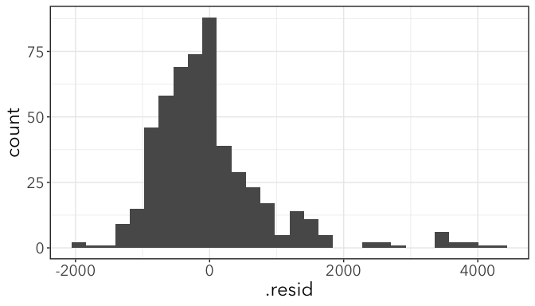

Slide 25
Marginal Hypothesis test
Anova(m1)
## Analysis of Deviance Table (Type II tests) ## ## Response: LocMax ## LR Chisq Df Pr(>Chisq) ## Origin 21.7862 1 3.048e-06 *** ## Treatment 11.4343 1 0.000721 *** ## Origin:Treatment 0.5008 1 0.479145 ## --- ## Signif. codes: 0 '***' 0.001 '**' 0.01 '*' 0.05 '.' 0.1 ' ' 1

Slide 26
Interaction plot
Use the “hack” to get means and confidence intervals and plot them.
An interaction plot (not dodged jitter like before)
m1b<-glm(LocMax ~ -1 + Origin:Treatment, family = gaussian, data = gh) coef(m1b)
## Originnon-roadside:Treatmentnoisy Originroadside:Treatmentnoisy ## 7168.837 7606.687 ## Originnon-roadside:Treatmentquiet Originroadside:Treatmentquiet ## 6975.960 7298.327
plotdata <- tibble(Origin = c("non-roadside", "roadside", "non-roadside", "roadside"), Treatment = c("noisy", "noisy", "quiet", "quiet"), LocMax = coef(m1b), ci.lower = confint(m1b)[ , 1], ci.upper = confint(m1b)[ , 2])

Slide 27
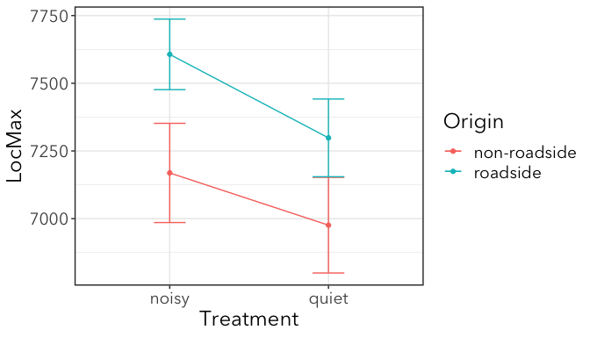

Slide 28
If there is no interaction, these lines are parallel. (Why? Work through the algerbra.)

Slide 29
Do smaller grashoppers make higher-pitched sounds?
Test with GLM of song pitch vs. body size

Slide 30
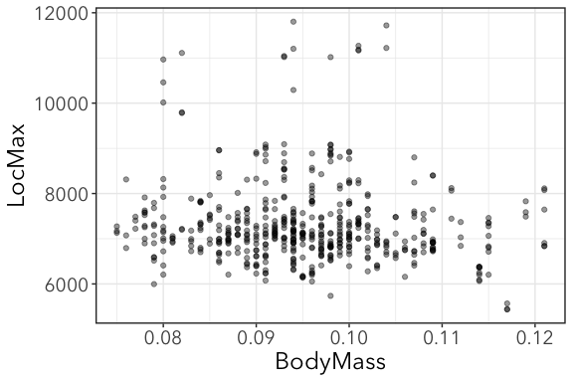

Slide 31
Regression GLM
$$E[x_{i}]=β_{0}+β_{1}×BodyMass_{i}$$
m2 <- glm(LocMax ~ BodyMass, family = gaussian, data = gh) Anova(m2)
## Analysis of Deviance Table (Type II tests) ## ## Response: LocMax ## LR Chisq Df Pr(>Chisq) ## BodyMass 4.8542 1 0.02758 * ## --- ## Signif. codes: 0 '***' 0.001 '**' 0.01 '*' 0.05 '.' 0.1 ' ' 1
coef(m2)
## (Intercept) BodyMass ## 8206.61 -9300.15

Slide 32
Plot the best fit line ± CI
To plot a best fit line, we can use geom_smooth()
NOTE: this only works well for simple models. Use with caution.
massplot + geom_smooth(method = "glm", level = 0.95, method.args = list(family = gaussian))
## `geom_smooth()` using formula 'y ~ x'

Slide 33
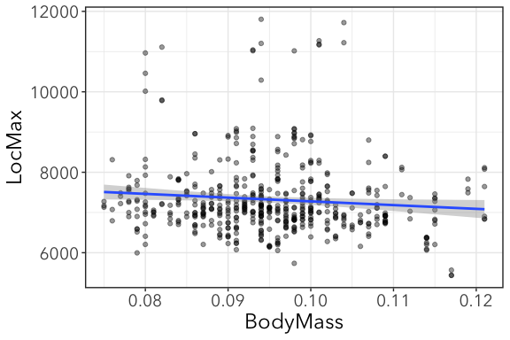

Slide 34
Why are CIs wider at extremes?
Confidence in intercept AND slope means less confident about about extreme values.

Slide 35
Does habitat origin affect body size?
2 dummy variables:
O (origin) = 1 if roadside, 0 if non-roadside
T (treatment) = 1 if noisy, 0 if quiet
$$E[BodySize_{i}]=β_{0}+β_{1}O+β_{2}T+β_{3}OT$$
m3 <- glm(BodyMass ~ Origin*Treatment, family = gaussian, data = gh) Anova(m3)
## Analysis of Deviance Table (Type II tests) ## ## Response: BodyMass ## LR Chisq Df Pr(>Chisq) ## Origin 2.23239 1 0.1351 ## Treatment 0.00897 1 0.9246 ## Origin:Treatment 1.64360 1 0.1998

Slide 36
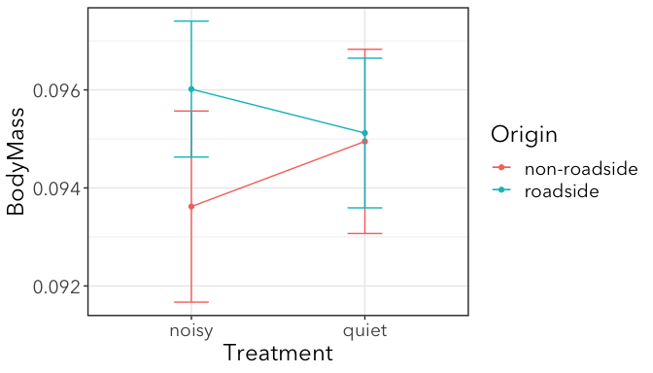

Slide 37
No significant effect of origin or treatment on size

Slide 38
Interaction of body size and noise
2 dummy variables:
O (Origin) = 1 if roadside, 0 if non-roadside
T (treatment) = 1 if noisy, 0 if quiet
$$E[x_{i}]=β_{0}+β_{1}O+β_{2}T+β_{3}BodyMass_{i}+β_{4}OT+β_{5}×O×BodyMass_{i}+β_{6}×T×BodyMass_{i}+β7×O×T×BodyMass_{i}$$
m4 <- glm(LocMax ~ Origin*Treatment*BodyMass, family = gaussian, data = gh)

Slide 39
Results
m4$call
## glm(formula = LocMax ~ Origin * Treatment * BodyMass, family = gaussian, ## data = gh)
Anova(m4)
## Analysis of Deviance Table (Type II tests) ## ## Response: LocMax ## LR Chisq Df Pr(>Chisq) ## Origin 23.9022 1 1.014e-06 *** ## Treatment 12.0041 1 0.0005308 *** ## BodyMass 7.0858 1 0.0077699 ** ## Origin:Treatment 0.7817 1 0.3766350 ## Origin:BodyMass 1.0395 1 0.3079399 ## Treatment:BodyMass 0.6213 1 0.4305612 ## Origin:Treatment:BodyMass 0.3728 1 0.5414588 ## --- ## Signif. codes: 0 '***' 0.001 '**' 0.01 '*' 0.05 '.' 0.1 ' ' 1
No significant interactions (whew). That means effects of mass, origin, and treatment are simply additive.

Slide 40
Plotting results
geom_smooth() won’t work here because it’s going to plot lines and confidence intervals for the full model. We have to build our own plot. Here’s one way:
Additive model:
mred <- glm(LocMax ~ Origin + Treatment + BodyMass, family = gaussian, data = gh)
Get fitted values and standard error as a data frame with augment() from the broom package
library(broom) pred <- augment(mred) head(pred %>% select(LocMax, Origin, Treatment, BodyMass, .fitted, .se.fit))
## # A tibble: 6 x 6 ## LocMax Origin Treatment BodyMass .fitted .se.fit ## <dbl> <chr> <chr> <dbl> <dbl> <dbl> ## 1 7193 non-roadside noisy 0.084 7318. 87.1 ## 2 7239 non-roadside noisy 0.084 7318. 87.1 ## 3 7358 non-roadside noisy 0.084 7318. 87.1 ## 4 8958 non-roadside noisy 0.086 7296. 83.5 ## 5 8452 non-roadside noisy 0.086 7296. 83.5 ## 6 8958 non-roadside noisy 0.086 7296. 83.5
ggplot(pred, aes(x = BodyMass, y = .fitted, color = Origin)) + geom_line(aes(group = Origin)) + geom_ribbon(aes(ymin = .fitted - .se.fit * 1.96, ymax = .fitted + .se.fit * 1.96, group = Origin), alpha = 0.2, color = NA) + facet_wrap(~Treatment) + labs(y = "LocMax")

Slide 41
